Slide 1
Isotopes of levitated particle rafts
Tchakamau Ra

Slide 2
Why study this?
Precedent with mixture of materials
Studies done on particles in colloids show that material properties matter
Arrangement mechanisms in ordinary clusters
Material properties
Glass, polystyrene have different densities, different speeds of sound

Slide 3
What are we studying?

Slide 4

What are the three shapes, and bonds?

Slide 5
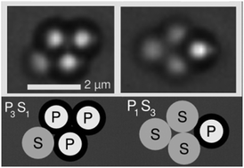
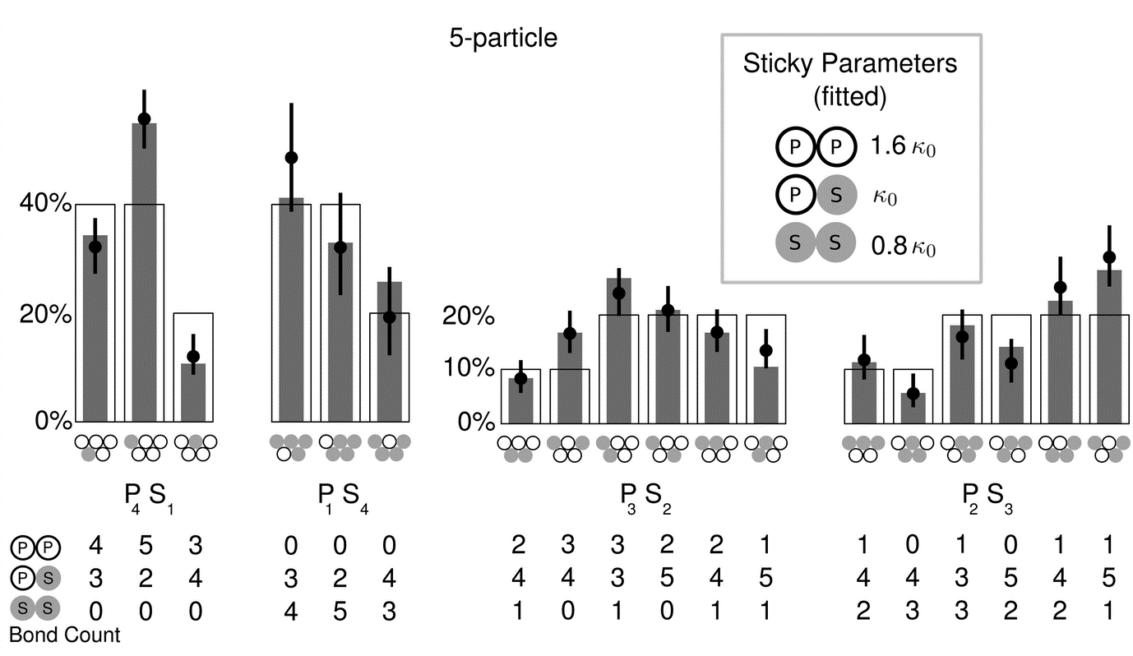
Why we think there’ll be a difference -this, and we saw one ourselves in the first data
Two particle types
Form rafts (depletion force)
Particle types called isotopes’ because bond networks formed with each are the same
Material properties of the spheres affect the probability of forming each raft arrangement

Slide 6
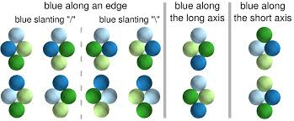
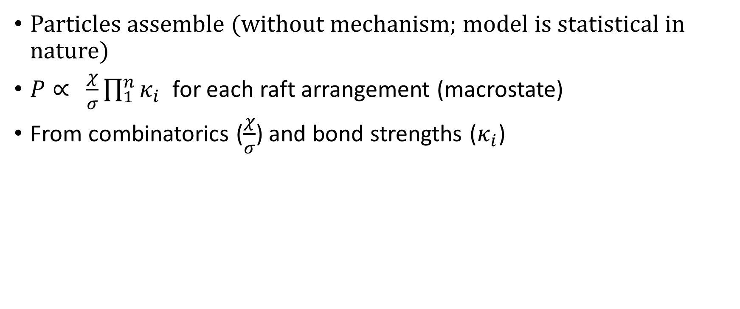
How to predict those probabilities (Perry et al.)?
Particles assemble (without mechanism; model is statistical in nature)
$P∝ \frac{χ}{σ}\prod_{1}^{n}{κ_{i}}$ for each raft arrangement (macrostate)
From combinatorics ($\frac{χ}{σ}$) and bond strengths ($κ_{i}$)

Slide 7
Markov modeling
Create a transition matrix from observed data
Observe how many transitions to and from each state (should be equal)
And note ratios
Create model transition matrices
Dependent on proposed methods of rearrangement for the particles
Include, in some mechanisms, dependence on bond strength
Compare

Slide 8
So what are we studying now?
Whgy the difdference exists
Weigtht differences
Some sirface schmizzle

Slide 9
What is this?
Purpose of experiment
`Well, everything’s mesed up already, so we already know so and sos are different.
We had first a set of glass and polyethylene particles, and then after lab cleaign they got switched; this is when we decided to wash them before using, so it’s no big deal, the data efore wan’t eing used.
The results acme in that all the mixed bonds were preferred, and also glass really hates itself. Then we decided to match the densities of the beads since it might be a weight thing causing the difference, i.e. maybe the glass just isn’t free rto move around because it is so heavy. So we witched out orur ‘glass’, for pokystyrene, dvb-crosslinked. Unbeknownst to us, this glass was itself polystyrene al lalong.
This is ojkay since the same reults cma ebakc a second time. Additionaly,we find out that the transitions being counted so far – the ones enriched in mixed bonding transitions – are the longer ones, because the thresholds which ork well to eliminate noisy countin,g especially on the diagonals, delete short transitions (only delete short transitiosn to nad form the saem state, fro the T-threshold, but could delete hsort trasntiions of all kinds from the messed up c-threshold if they never sta talbe, long, but at least, when I went through the results manually from one run, raft times of less than 40 frames are vanishginly – very – rare, so it’s probably nto ths threshold that messes everything up, but the other one. When it’s the t-threshold, tyou’d expect that same tate transitions alone are beign miscounted, so actually if it has this much effect, it’s kind of suggestignt hat most transitions are same-state. If most transtions are same- state by the way , we’ve got to find out why that could happen, because if any state can ‘like’ itself, then the particles never reall yescape form the ‘trap’ of a single state, to form a new one. Why a state should be a trap, in that there’s no rotation of the raft or the particles once within the well proper, I don’t know, and I don’t even know if it’s a thing, as sometimes clearly the raft does rotate. But what if it does so a lot less, when the ball doesn’t leave, or the ball which leaves can move to a new spot a lot further around the raft, wnen it leaves?

Slide 10
What assumptions go into model, that might be broken?
Arrangement mechanisms in ordinary clusters
Lim et al. – two modes of rearrangement
Sticky
Ergodic
All of mine are ergodic assumptions, maybe trghats the problem, because the states aren’t equally likely because rthey have history.

Slide 11
Note: two different scattering regimes, two different mechanisms of motion

Slide 12
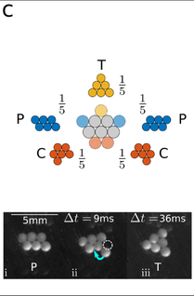
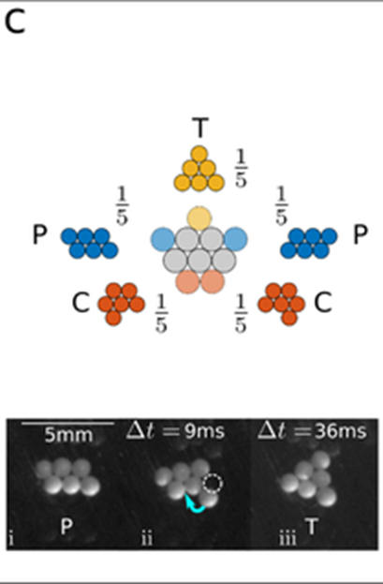
Motions
Hinge
Show pobs: / show transititon matrix percs
Break apart
Show pobs: / show transititon matrix percs

Slide 13
Original reesults

Slide 14
Duplicating the strudty
Happened accidentally, and here’s what came of doing so

Slide 15
Why cjhhhange the syudy materials?
Material properties
Glass, polystyrene have different densities, so maybe glass wasn’t free to move about, or hit the glass slide more often
So use a kighter material, desity athed wit polystyrene

Slide 16
Making predictions
Models
Edge particles move, can go one space left or right
Same, but can go back to old spot
Same, but can go to any spot
Can go to any spot, but only left particle moves
End state just proportional to #bonds * bond strengths

Slide 17
Results
Some models fit better than others
Not lots of agreement on second data set

Slide 18
Actors affecting accuracy of this data

